Slide 1
Introduction to the Semantic Web
Payam Barnaghi

Slide 2

The Semantic Web
“The Semantic Web is an extension of the current web in which information is given well-defined meaning, better enabling computers and people to work in co-operation.“ [Berners-Lee et al, 2001]

Slide 3
Today’s Web
Currently most of the Web content is suitable for human use.
Typical uses of the Web today are information seeking, publishing, and using, searching for people and products, shopping, reviewing catalogues, etc.
Dynamic pages generated based on information from databases but without original information structure found in databases.

Slide 4
Limitations of the Web Search today
The Web search results are high recall, low precision.
Results are highly sensitive to vocabulary.
Results are single Web pages.
Most of the publishing contents are not structured to allow logical reasoning and query answering.

Slide 5
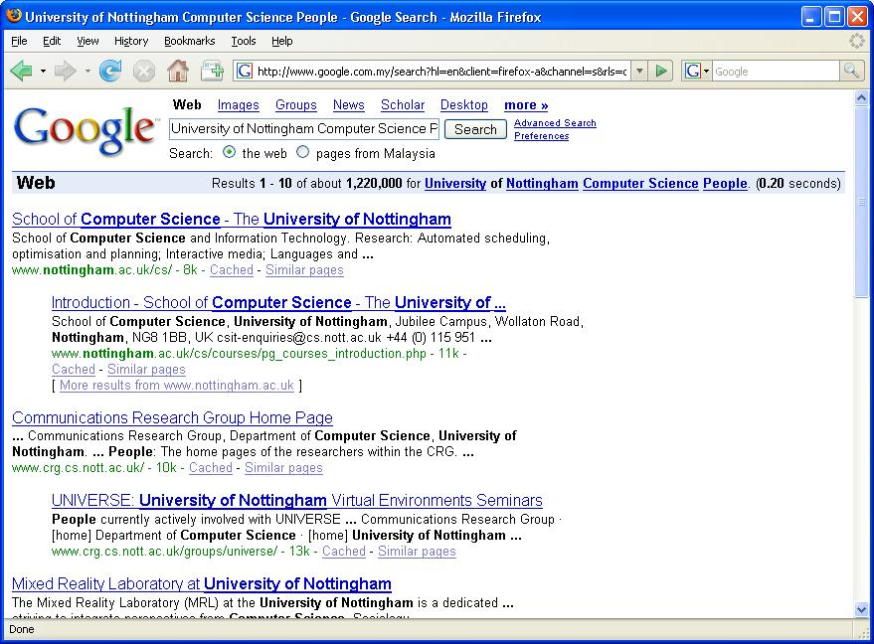
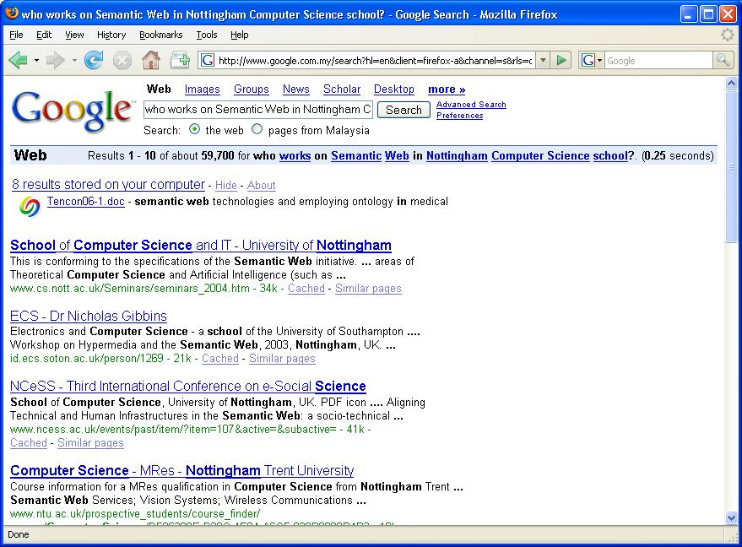
Today’s Web

Slide 6
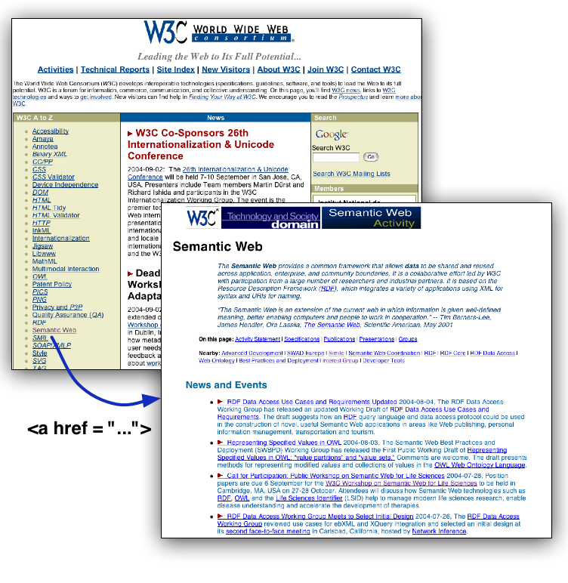
What is a Web of Data?
Thinking back a bit... 1994
HTML and URIs
Markup language and means for connecting resources
Below the file level
Stopped at the text level
[Miller 04]

Slide 7
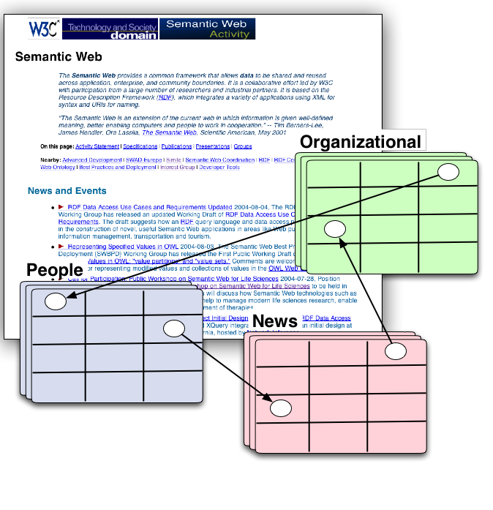
What is a Web of Data? (continued)
Now
XML, RDF, OWL and URIs
Markup language and means for connecting resources
Below the file level
Below the text level
At the data level
[Miller 04]

Slide 8
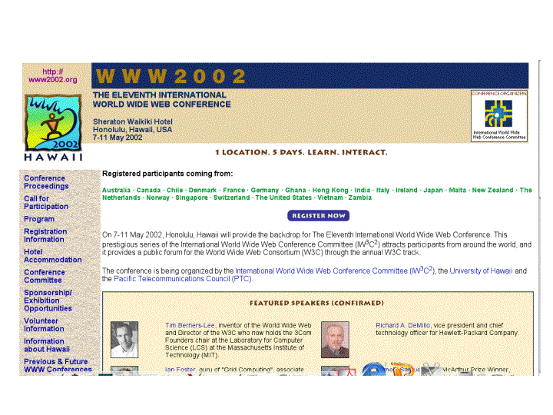
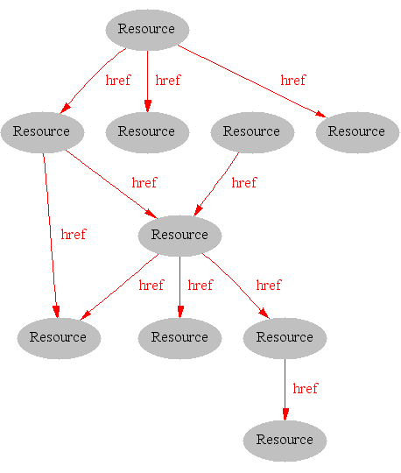
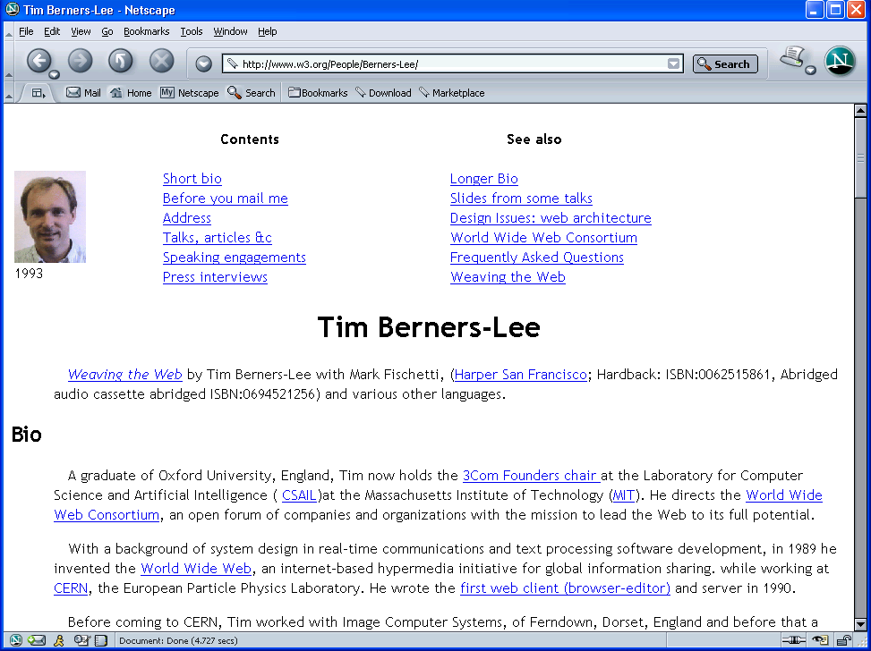
The Syntactic Web
[Hendler & Miller 02]

Slide 9
What is the Problem?
Consider a typical web page:
Markup consists of:
rendering information (e.g., font size and colour)
Hyper-links to related content
Semantic content is accessible to humans but not (easily) to computers…
[Davies, 03]

Slide 10
i.e. the Syntactic Web is…
A place where
computers do the presentation (easy) and
people do the linking and interpreting (hard).
Why not get computers to do more of the hard work?
[Goble, 03]

Slide 11
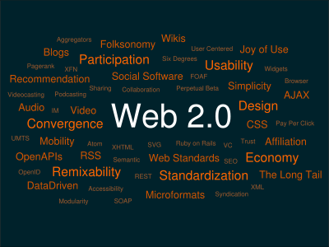





Web 2
It is all about people, collaboration, media, ...
[The mind-map pictured above constructed by Markus Angermeier, source Wikipedia]

Slide 12
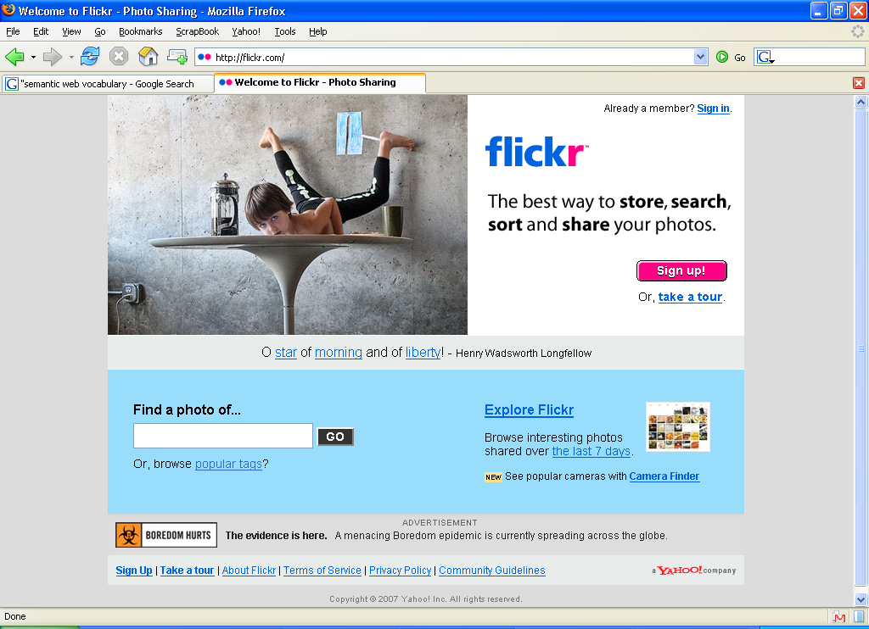
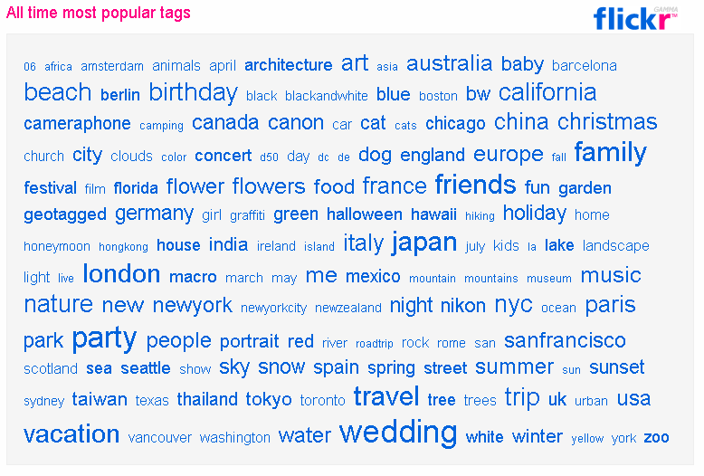
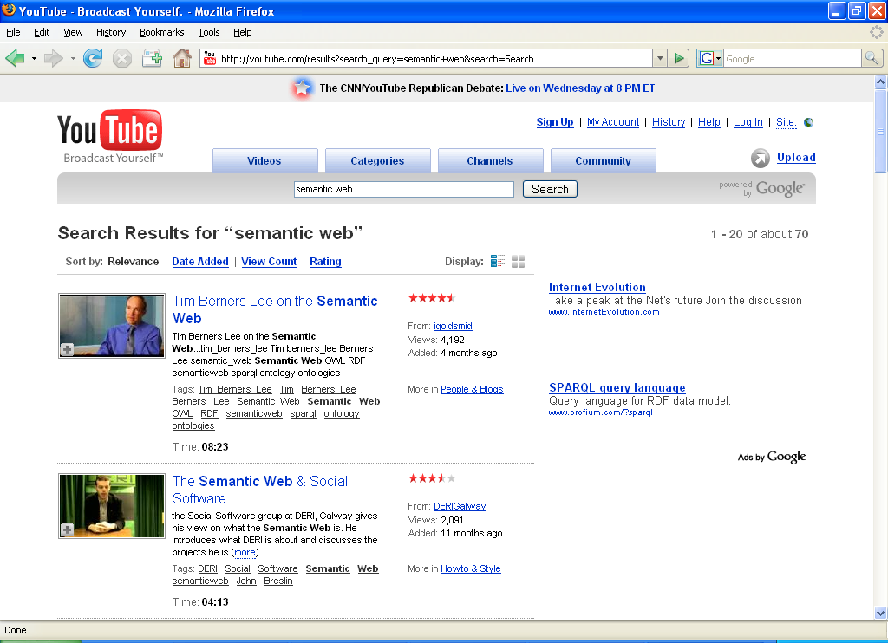
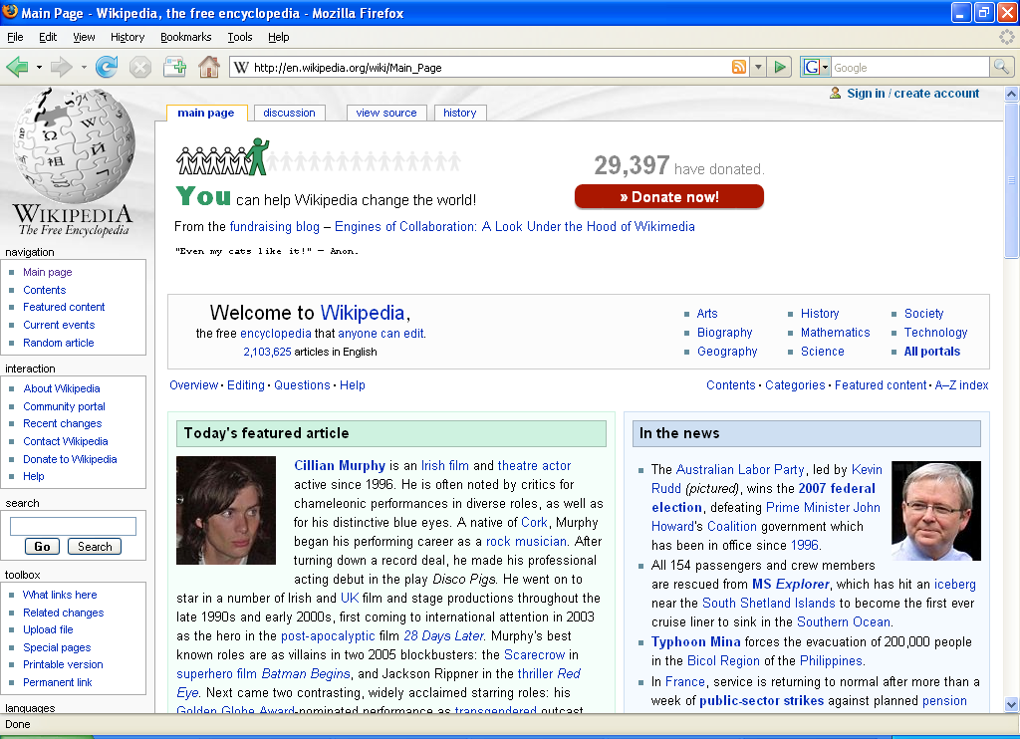
Web 2.0 and Folksonomies
[http://flickr.com/photos/tags/]

Slide 13
Machine-accessible Content
The main obstacle to provide better support to Web users is that, at present , the meaning of Web content is not machine accessible.
Although there are tools to retrieve texts, but when it comes to interpreting sentence and extracting useful information for the user, the capabilities of current software are still very limited.

Slide 14
Distinguishing the meaning
It is simply difficult for machines to distinguish the meaning of:
I am a philosopher.
from
I am a philosopher, you may think. Well,…

Slide 15

…Limitations of the Web today
The Web activities are mostly focus on Machine-to-Human,
and Machine-to-Machine activities are not particularly well
supported by software tools.
[Davies, 03]

Slide 16
How Can the Current Situation be Improved?
An alternative approach is to represent Web content in a form that is more easily machine-accessible and to use intelligent techniques to take advantage of these presentations.

Slide 17
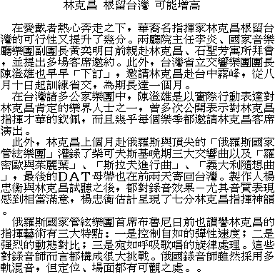
Machine Accessible Meaning
name
education
CV
work
private
[Davies, 03]

Slide 18
XML
User definable and domain specific markup
HTML:
<H1>Internet and World Wide Web</H1> <UL>
<LI>Code: G52IWW <LI>Students: Undergraduate </UL>
XML:
<module> <title>Internet and World Wide Web</title> <code>G52IWW</code> <students>Undergraduate</students> </module>

Slide 19
XML: Document = labeled tree
node = label + contents
<module date=“...”> <title>...</title> <lecturer>
<name>...</name>
<weblink>...</weblink>
</lecturer> <students>...</students> </module>
module
=
title
lecturer
students
name
weblink
DTD: describe the grammar and structure of
permissible XML trees

Slide 20
But What about this?
< ναμε >
< >
name
<εδυχατιον>
< >
education
< Χς >
< >
CV
<ωορκ>
< >
work
<πριϖατε>
< >
private
[Davies, 03]

Slide 21
XML
Meaning of XML-Documents is intuitively clear
due to "semantic" Mark-Up
tags are domain-terms
But, computers do not have intuition
tag-names do not provide semantics for machines.
DTDs or XML Schema specify the structure of documents, not the meaning of the document contents
XML lacks a semantic model
has only a "surface model”, i.e. tree

Slide 22
XML: limitations for semantic markup
XML representation makes no commitment on:
Domain specific ontological vocabulary
Which words shall we use to describe a given set of concepts?
Ontological modelling primitives
How can we combine these concepts, e.g. “car is a-kind-of (subclass-of) vehicle”
⇨ requires pre-arranged agreement on vocabulary and primitives
Only feasible for closed collaboration
agents in a small & stable community
pages on a small & stable intranet .. not for sharable Web-resources
[Davies, 03]

Slide 23
XML is a first step
Semantic markup
HTML ⇨ layout
XML ⇨ content
Metadata
within documents, not across documents
prescriptive, not descriptive
No commitment on vocabulary and modelling primitives
RDF is the next step
[Davies, 03]

Slide 24
Resource Description Framework (RDF)
A standard of W3C
Relationships between documents
Consisting of triples or sentences:
<subject, property, object>
<“Mozart”, composed, “The Magic Flute” >
RDFS extends RDF with standard “ontology vocabulary”:
Class, Property
Type, subClassOf
domain, range
Notes:
RDF is an XML application defined using a document type definition (DTD). A DTD was used because the design of RDF essentially pre-dates XML schema.
RDF is made up of triples which are like simple grammatical sentences with a subject, a verb and an object (in that order). The subject and the verb will be a URI, the object may be a URI or may be a literal. A literal is a character string or other primitive datatype defined by XML.
The uniqueness of the URI convention prevents confusion. Frequently the URI will be a URL where information about the data is stored. E.g. if I want to represent myself (Paul Warren) uniquely then I can create a URL somewhere (with a reasonable chance of guaranteeing persistence). The URL may have a descriptive identifier, e.g. …johnDavies.htm - but this is merely incidental. The page pointed at should preferably say something about the fact that the URL represents me. What we do require is that the URL be persistent.
Someone else, e.g. the tax office, may construct a URI representing me, and all the intelligent agents in the world will be blissfully ignorant that the two URIs refer to the same person … until a human intervenes and defines an equivalence between them.
Besides URLs, other forms of URI include identification of electronic mailboxes.

Slide 25
RDF for semantic annotation
RDF provides metadata about Web resources
Object -> Attribute-> Value triples
It has an XML syntax
Chained triples form a graph
http://sepang.nottingham.edu.my/~bpayam/images/payam-barnaghi.png
has_image
http://sepang.nottingham.edu.my/~bpayam/#Payam
UNiM
#Payam
has_email
payam@nottingham
has_owner
has_teaching
http://www.nottingham.edu.my/CSIT/G53ELC
<rdf:Description rdf:about=“#Payam”>
<has_email>payam@nottingham</has_email>
</rdf:Description>
Notes:
RDF has reification. Graph data model, property-centric approach.

Slide 26
RDF: Basic Ideas
Resources
Every resource has a URI (Universal Resource Identifier)
A URI can be a URL (a web address) or a some other kind of identifier;
An identifier does not necessarily enable access to a resources
We can think of a resources as an object that we want to describe it.
Books
Person
Places, etc.

Slide 27
RDF: Basic Ideas
Properties
Properties are special kind of resources;
Properties describe relations between resources.
For example: “written by”, “composed by”, “title”, “topic”, etc.
Properties in RDF are also identified by URIs.
This provides a global, unique naming scheme.

Slide 28

RDF: Basic Ideas
Statements
A statement is an object-attribute-value triple.
It consists of a resources, a property, and a value.
http://mitpress.mit.edu/catalog/item/default.asp?ttype=2&tid=10140
#MIT Press
publishedBy

Slide 29
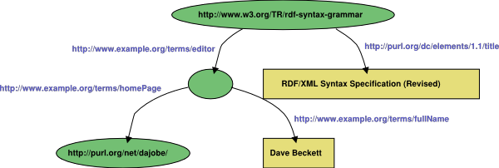
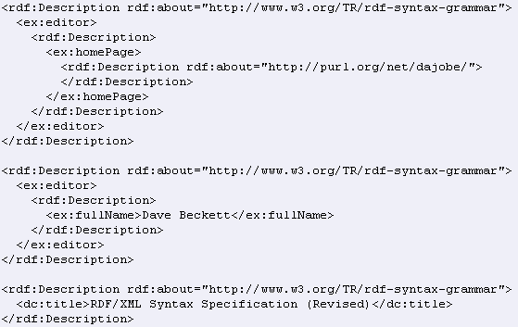
RDF: Example

Slide 30
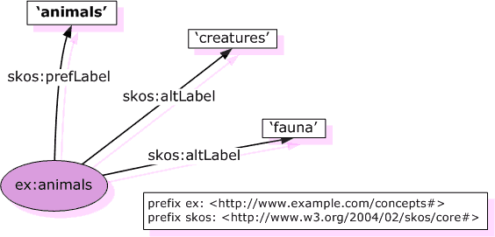
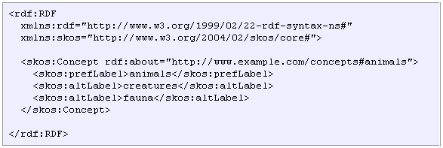
RDF Example
Source: http://www.w3.org/TR/swbp-skos-core-guide/

Slide 31
RDF Schema: Basic Ideas
RDF is a universal language that enables users to describe their own vocabularies.
But, RDF does not make assumption about any particular domain.
It is up to user to define this in RDF schema.

Slide 32
What does RDF Schema add?
Defines vocabulary for RDF
Organizes this vocabulary in a typed hierarchy
Class, subClassOf, type
Property, subPropertyOf
domain, range
Staff
subClassOf
subClassOf
Schema(RDFS)
Lecturer
domain
range
Research Assistant
supervisedBy
type
type
Tom
supervisedBy
Alan
Data(RDF)
[adapted from: Studer et al, 04]

Slide 33
Querying RDF data
Query Languages such as SPARQL, RQL.
RDF is a directed, labeled graph data format for representing information in the Web.
Most forms of the query languages contain a set of triple patterns.
Triple patterns are like RDF triples except that each of the subject, predicate and object may be a variable.

Slide 34
Basic Queries
The example provided in RQL.
Using select-from-where
select specifies the number and order of retrieved data.
from is used to navigate through the data model.
where imposes constraints on possible solutions

Slide 35
Basic Queries: Example
select X,Y
From {X} writtenBy {Y}
X, Y are variables, {X} writtenBy {Y} represents a resource-property-value triple

Slide 36
Conclusions about RDF(S)
Next step up from plain XML:
(small) ontological commitment to modeling primitives
possible to define vocabulary
However:
no precisely described meaning
no inference model
[Davies, 03]
Notes:
RDFS provides some KR techniques, but is still not sufficient for applying real KR to semi-structured data on the web.
how to apply KR - ontologies - to semi-structured data on the internet?
only natural language spec.
Only subsumption inference possible, no: transitivity, inverse, etc.

Slide 37
Ontologies
The term ontology is originated from philosophy. In that context it is used as the name of a subfield of philosophy, namely, the study of the nature of existence.
For the Semantic Web purpose:
“An ontology is an explicit and formal specification of a conceptualisation”. (R. Studer)

Slide 38
Ontologies and Semantic Web
In general, an ontology describes formally a domain of discourse.
An ontology consists of a finite list of terms and the relationships between the terms.
The terms denote important concepts classes of objects) of the domain.
For example, in a university setting, staff members, students, courses, modules, lecture theatres, and schools are some important concepts.

Slide 39
Ontologies and Semantic Web (cont’d)
In the context of the Web, ontologies provide a shared understanding of a domain.
Such a shared understanding is necessary to overcome the difference in terminology.
Ontologies are useful for improving accuracy of Web searches.
Web searches can exploit generalization/specialization information.

Slide 40
A Sample Ontology
Object
is_a
Person
knows
Topic
described_in
Document
is_a
writes
Student
Researcher
Semantics
F-Logic
Ontology
is_a
subTopicOf
similar
Doktoral Student
Affiliation
PhD Student
PhD Student
F-Logic
Ontology
PhD Student
Rules
instance_of
T
similar
D
T
D
described_in
is_about
Tel
Affiliation
Affiliation
Siggi
P
writes
D
is_about
T
P
knows
T
+49 721 608 6554
AIFB
Major Paradigms: Logic Programming, Description Logic
Standards: RDF(S); OWL
[Studer et al, 04]

Slide 41
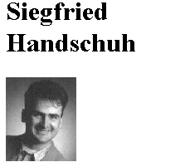
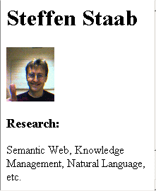

Ontology & Annotation
Ontology
cooperate_with
rdfs:domain
rdfs:range
AcademicStaff
rdfs:subClassOf
rdfs:subClassOf
PhD Student
AssProf
instance of
instance of
<swrc:PhD_Student rdf:ID="sha"> <swrc:name>Siegfried Handschuh</swrc:name>
...
</swrc:PhD_Student>
<swrc:AssProf rdf:ID="sst">
<swrc:name>Steffen Staab </swrc:name>
...
</swrc:AssProf>
Anno- tation
<swrc:cooperate_with rdf:resource = "http://www.aifb.uni- karlsruhe.de/WBS/sst#sst"/>
Cooperate_with
Links have explicit meanings!
Web Page
[Studer et al, 04]
URL
http://www.aifb.uni-karlsruhe.de/WBS/sha
http://www.aifb.uni-karlsruhe.de/WBS/sst

Slide 42
Ontologies (OWL)
RDFS is useful, but does not solve all possible requirements
Complex applications may want more possibilities:
similarity and/or differences of terms (properties or classes)
construct classes, not just name them
can a program reason about some terms? E.g.:
“if «Person» resources «A» and «B» have the same «foaf:email» property, then «A» and «B» are identical”
etc.
This lead to the development of OWL (Web Ontology Language)
source: Introduction to the Semantic Web, Ivan Herman, W3C

Slide 43
Ontology Languages for the Web
RDF Schema is a vocabulary description language for describing properties and classes of RDF resources, with a semantics for generalization hierarchies of such properties and classes.
OWL is a richer vocabulary description language for describing properties and classes.

Slide 44
OWL Language
OWL is based on Description Logics knowledge representation formalism
OWL (DL) benefits from many years of DL research:
Well defined semantics
Formal properties well understood (complexity, decidability)
Known reasoning algorithms
Implemented systems (highly optimised)
Three species of OWL
OWL full is union of OWL syntax and RDF
OWL DL restricted to FOL fragment
OWL Lite is “easier to implement” subset of OWL DL
OWL DL based on SHIQ Description Logic
[Davies, 03]

Slide 45
Classes in OWL
In RDFS, you can subclass existing classes… that’s all.
In OWL, you can construct classes from existing ones:
enumerate its content
through intersection, union, complement
through property restrictions
source: Introduction to the Semantic Web, Ivan Herman, W3C

Slide 46
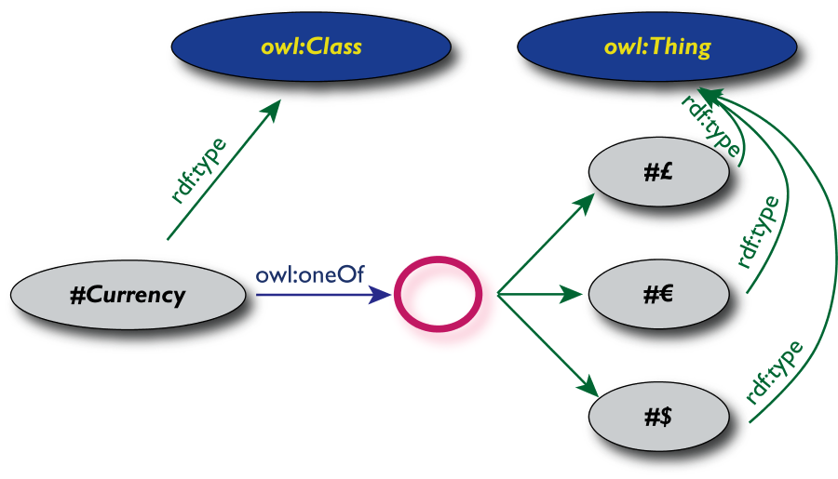
OWL classes can be “enumerated”
The OWL solution, where possible content is explicitly listed:
source: Introduction to the Semantic Web, Ivan Herman, W3C

Slide 47
Why develop an ontology?
To make define web resources more precisely and make them more amenable to machine processing
To make domain assumptions explicit
Easier to change domain assumptions
Easier to understand and update legacy data
To separate domain knowledge from operational knowledge
Re-use domain and operational knowledge separately
A community reference for applications
To share a consistent understanding of what information means
[Davies, 03]

Slide 48
Ontology and Logic
Reasoning over ontologies
Inferencing capabilities
X is author of Y ⇨ Y is written by X
X is supplier to Y; Y is supplier to Z ⇨
X and Z are part of the same supply chain
Cars are a kind of vehicle;
Vehicles have 2 or more wheels ⇨
Cars have 2 or more wheels
[Davies, 03]

Slide 49
Logic and Inference
Logic is the discipline that studies the principles of reasoning
Formal languages for expressing knowledge
Well-understood formal semantics
Declarative knowledge: we describe what holds without caring about how it can be deduced
Automated reasoners can deduce (infer) conclusions from the given knowledge
source: A Semantic Web Primer, Grigoris Antoniou and Frank van Harmelen, MIT Press

Slide 50
An Inference Example
prof(X)  faculty(X)
faculty(X)  staff(X)
prof(michael)
We can deduce the following conclusions:
faculty(michael)
staff(michael)
prof(X)  staff(X)
source: A Semantic Web Primer, Grigoris Antoniou and Frank van Harmelen, MIT Press

Slide 51
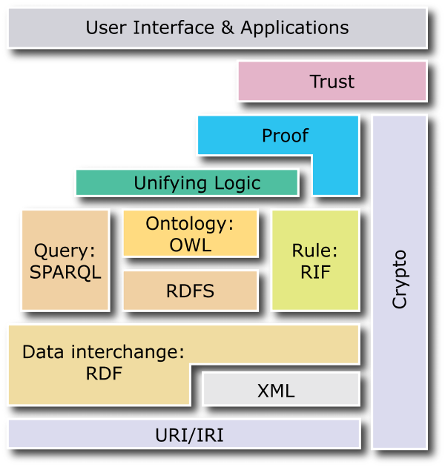
Semantic Web Vision
Machine-processable, global Web standards:
Assigning unambiguous names (URI)
Expressing data, including metadata (RDF)
Capturing ontologies (OWL)
Query, rules, transformations, deployment, application spaces, logic, proofs, trust (in progress)
[Source: Emerging Web Technologies to Watch, Steve Bratt, W3C]

Slide 52
Semantic Web and AI?
No human-level intelligence claims
As with today’s WWW
large, inconsistent, distributed
Requirements
scalable, robust, decentralised
tolerant, mediated
Semantic Web will make extensive use of current AI,
any advancement in AI will lead to a better Semantic Web
Current AI is already sufficient to go towards realizing the semantic web vision
As with WWW, Semantic Web will (need to) adapt fast
[Davies, 03]

Slide 53
Semantic Web & Knowledge Management
Organising knowledge in conceptual spaces according to its meaning.
Enabling automated tools to check for inconsistencies and extracting new knowledge.
Replacing query-based search with query answering.
Defining who may view certain parts of information

Slide 54

Semantic Web Services

Slide 55
Web Services
Web Services provide data and services to other applications.
Thee applications access Web Services via standard Web Formats (HTTP, HTML, XML, and SOAP), with no need to know how the Web Service itself is implemented.
You can imagine a web service like a remote procedure call (RPC) which it returns a message in an XML format.

Slide 56
Web Services
loosely coupled, reusable components
encapsulate discrete functionality
distributed
programmatically accessible over standard internet protocols
add new level of functionality on top of the current web
[Stollberg et al., 05]

Slide 57
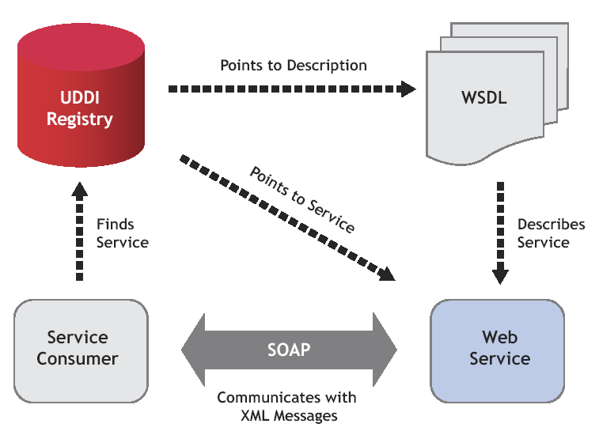
The Promise of Web Services
[Stollberg et al., 05]

Slide 58
Deficiencies of WS Technology
Current technologies allow usage of Web Services
but:
only syntactical information descriptions
syntactic support for discovery, composition and execution
=> Web Service usability, usage, and integration needs to be inspected manually
no semantically marked up content / services
no support for the Semantic Web
=> current Web Service Technology Stack failed to
realize the promise of Web Services
[Stollberg et al., 05]

Slide 59
Semantic Web Services
Semantic Web Technology
+
Web Service Technology
allow machine supported data interpretation
ontologies as data model
automated discovery, selection, composition,
and web-based execution of services
=> Semantic Web Services as integrated solution for realizing the vision of the next generation of the Web
[Stollberg et al., 05]

Slide 60
Semantic Web Services
define exhaustive description frameworks for describing Web Services and related aspects (Web Service Description Ontologies)
support ontologies as underlying data model to allow machine supported data interpretation (Semantic Web aspect)
define semantically driven technologies for automation of the Web Service usage process (Web Service aspect)

Slide 61
Acknowledgements
Some of the slides are adapted from the following resources:
Semantic Web, John Davies, Next Generation Web Research, BT.
A Short Semantic Web Tutorial, Andreas Hotho & York Sure, Knowledge Management Group, Institute AIFB, University of Karlsruhe.
Semantic Web and Ontology Management, Rudi Studer, York Sure, Christoph Tempich, Peter Haase,Institute AIFB, University of Karlsruhe.
A Semantic Web Primer, Grigoris Antoniou and Frank van Harmelen, ISBN 0-262-01210-3, 2004, the MIT press.
The Semantic Web: A Web of Machine Processible Data, Eric Miller, W3C Semantic Web Activity Lead, 2004.
Stollberg et al, Semantic Web Services Tutorial, 5th International Conference on Web Engineering (ICWE 2005), Sydney, Australia.
Introduction to the Semantic Web, Ivan Herman, W3C, 2007.

Slide 62
Suggested Readings
A Semantic Web Primer, Grigoris Antoniou and Frank van Harmelen, ISBN 0-262-01210-3, 2004, the MIT press.
W3C Semantic Web
http://www.w3.org/2001/sw/
The Semantic Web Community Portal, http://www.semanticweb.org

